Slide 1
What’s New in Bootstrap v4
Joseph Guadagno
jguadagno@hotmail.com
@jguadagno
http://jjg.me/aboutJJG

Slide 2
About Joseph Guadagno
Team Leader at Quicken Loans
Organizer of Desert Code Camp
Microsoft .NET MVP
“Friend” of Redgate
Father of 2, husband to 1
Notes:
Former President and Vice President of INETA North America (2007-2015)
Founder of the Southeast Valley .NET User Group (SEVDNUG) in Chandler, AZ (2007-2013)
Currently serving on my the City of Chandler‘s Parks and Recreation board (since 2010)
Telerik MVP (2010 to 2012)
Microsoft Visual Basic MVP (1996)

Slide 3
Agenda
What’s New with Layouts
What’s New with Content
What’s New with Components
What’s New with Utilities
Migrations

Slide 4
Layout

Slide 5
New to Layout
Flexbox (Utilities)
http://jjg.me/flexbox-css-tricks
Grid Features
Responsive Utilities
Notes:
Flexbox
Quickly manage the layout, alignment, and sizing of grid columns, navigation, components, and more with a full suite of responsive flexbox utilities.
https://v4-alpha.getbootstrap.com/utilities/flexbox/
Grid Features
Extra small <576px Small ≥576px
Medium ≥768px Large ≥992px Extra large ≥1200px
Auto Layout Columns Class=‘col’
Alignment
Response Utilities
The .hidden-*-up classes hide the element when the viewport is at the given breakpoint or wider. For example, .hidden-md-up hides an element on medium, large, and extra-large viewports.
The .hidden-*-down classes hide the element when the viewport is at the given breakpoint or smaller. For example, .hidden-md-down hides an element on extra-small, small, and medium viewports.

Slide 6
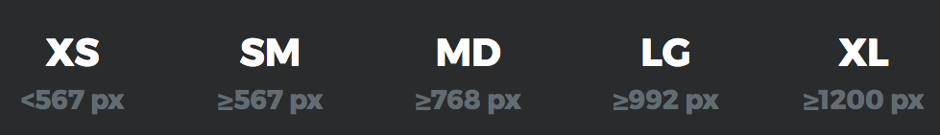
Breakpoints

Slide 7
Content

Slide 8
New to Content
“Reboot”
The Approach
Native Fonts
Click Delay Optimizations
Typography
Display Heading
Notes:
Reboot
Part of Bootstrap’s job is to provide an elegant, consistent, and simple baseline to build upon. We use Reboot, a collection of element-specific CSS changes in a single file, to kickstart that.
Reboot builds upon Normalize, providing many HTML elements with somewhat opinionated styles using only element selectors. Additional styling is done only with classes. For example, we reboot some <table> styles for a simpler baseline and later provide .table, .table-bordered, and more.
Native Font Stack
The default web fonts (Helvetica Neue, Helvetica, and Arial) have been dropped in Bootstrap 4 and replaced with a “native font stack” for optimum text rendering on every device and OS.
Click Delay
Traditionally, browsers on touchscreen devices have a delay of approximately 300ms between the end of a “tap” – the moment when a finger/stylus is lifted from screen – and the click event being fired. This delay is necessary for these browsers to correctly handle “double-tap to zoom” gestures without prematurely triggering actions or links after the first “tap”, but it can make your site feel slightly sluggish and unresponsive.
Display Heading
Traditional heading elements are designed to work best in the meat of your page content. When you need a heading to stand out, consider using a display heading—a larger, slightly more opinionated heading style.

Slide 9
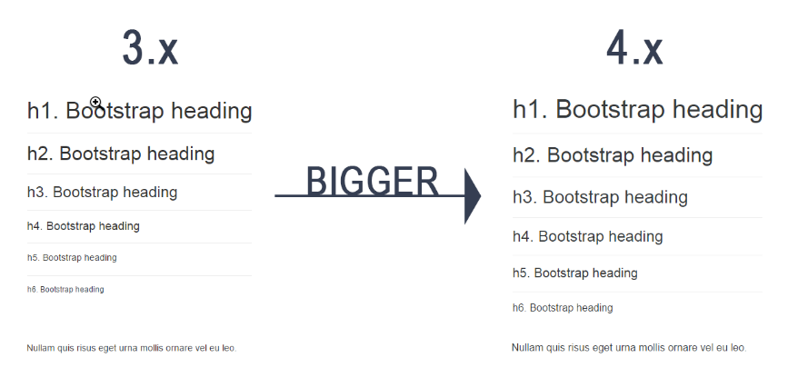
Fonts

Slide 10
Components

Slide 11
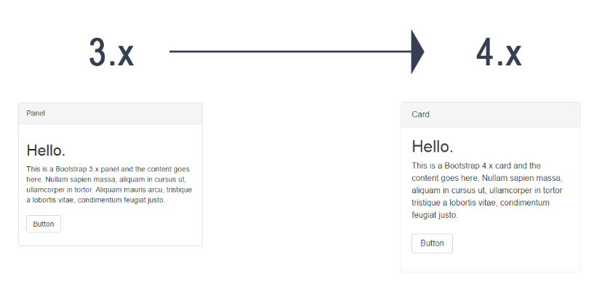
New to Components
Card

Slide 12
Utilities

Slide 13
New to Utilities
Display
Typography
Font Weight
Vertical Alignment
Notes:
Show this

Slide 14
New to Utilities
Border
”Invisible” Content
Position
Sizing
Spacing

Slide 15
Migrations
https://v4-alpha.getbootstrap.com/migration/

Slide 16
Browser Support
Not supported anymore
IE8, IE9 and iOS 6
Supported
IE10+, iOS 7+
Android Lollipop Browser and WebView (Current)

Slide 17
Global Changes
Flexbox Enabled by Default
Switched from Less to Sass
Switched from px to rem
Font Size
Uses Native Fonts for the OS (except Linux)
Notes:
Rem: Relative to font-size of the root element

Slide 18
Components Dropped
Panels
Thumbnails
Wells
Glyphicons Icon Font
Affix jQuery plugin
Pager Component

Slide 19
Grid System
Added support for flexbox in the grid
Included support for vertical and horizontal alignment classes.
Added a new sm grid tier below 768px for more granular control.
Changed grid system media query breakpoints and container widths to account for new grid tier and ensure columns are evenly divisible by 12 at their max width.
Notes:
Added support for flexbox in the grid mixins and predefined classes.
As part of flexbox, included support for vertical and horizontal alignment classes.
Overhauled grid mixins to merge make-col-span into make-col for a singular mixin.
Added a new sm grid tier below 768px for more granular control. We now have xs, sm, md, lg, and xl. This also means every tier has been bumped up one level (so .col-md-6 in v3 is now .col-lg-6 in v4).
Changed grid system media query breakpoints and container widths to account for new grid tier and ensure columns are evenly divisible by 12 at their max width.
Grid breakpoints and container widths are now handled via Sass maps ($grid-breakpoints and $container-max-widths) instead of a handful of separate variables. These replace the @screen-*variables entirely and allow you to fully customize the grid tiers.
Media queries have also changed. Instead of repeating our media query declarations with the same value each time, we now have @include media-breakpoint-up/down/only. Now, instead of writing @media (min-width: @screen-sm-min) { ... }, you can write @include media-breakpoint-up(sm) { ... }.

Slide 20
Component Changes - Typography
.dl-horizontal has been dropped.
Custom <blockquote> styling has moved to classes
.list-inline now requires that its children list items have the new .list-inline-item class applied to them.
Notes:
Moved all .text- utilities to the _utilities.scss file.
Dropped .page-header as, aside from the border, all its styles can be applied via utilities.
.dl-horizontal has been dropped. Instead, use .row on <dl> and use grid column classes (or mixins) on its <dt> and <dd> children.
Custom <blockquote> styling has moved to classes—.blockquote and the .blockquote-reverse modifier.
.list-inline now requires that its children list items have the new .list-inline-item class applied to them.

Slide 21
Component Changes - Images
Renamed .img-responsive to .img-fluid.
Renamed .img-rounded to .rounded
Renamed .img-circle to .rounded-circle

Slide 22
Component Changes - Tables
Responsive tables no longer require a wrapping element. Instead, just put the .table-responsive right on the <table>.
Renamed .table-condensed to .table-sm for consistency.
Added a new .table-inverse option.
Added table header modifiers: .thead-default and .thead-inverse.
Renamed contextual classes to have a .table--prefix
Notes:
Nearly all instances of the > selector have been removed, meaning nested tables will now automatically inherit styles from their parents. This greatly simplifies our selectors and potential customizations.
Responsive tables no longer require a wrapping element. Instead, just put the .table-responsive right on the <table>.
Renamed .table-condensed to .table-sm for consistency.
Added a new .table-inverse option.
Added table header modifiers: .thead-default and .thead-inverse.
Renamed contextual classes to have a .table--prefix. Hence .active, .success, .warning, .danger and .table-info to .table-active, .table-success, .table-warning, .table-danger and .table-info.

Slide 23
Component Changes - Forms
Renamed .control-label to .form-control-label.
Renamed .input-lg and .input-sm to .form-control-*
Dropped .form-group-* classes for simplicity’s sake.
Dropped .help-block and replaced it with .form-text
Added custom forms support (for checkboxes, radios, selects, and file inputs).
Notes:
Moved element resets to the _reboot.scss file.
Renamed .control-label to .form-control-label.
Renamed .input-lg and .input-sm to .form-control-lg and .form-control-sm, respectively.
Dropped .form-group-* classes for simplicity’s sake. Use .form-control-*classes instead now.
Dropped .help-block and replaced it with .form-text for block-level help text. For inline help text and other flexible options, use utility classes like .text-muted.
Added custom forms support (for checkboxes, radios, selects, and file inputs).

Slide 24
Component Changes – Forms - Horizontal
Dropped the .form-horizontal class requirement.
. <div class="form-group row">
Added new .form-control-label class to vertically center labels with .form-controls.
Notes:
Dropped the .form-horizontal class requirement.
.form-group no longer applies styles from the .row via mixin, so .row is now required for horizontal grid layouts (e.g., <div class="form-group row">).
Added new .form-control-label class to vertically center labels with .form-controls.

Slide 25
Component Changes – Buttons
Renamed .btn-default to .btn-secondary.
Dropped the .btn-xs class entirely
The stateful button feature of the button.js jQuery plugin has been dropped.
Notes:
Renamed .btn-default to .btn-secondary.
Dropped the .btn-xs class entirely as .btn-sm is proportionally much smaller than v3’s.
The stateful button feature of the button.js jQuery plugin has been dropped. This includes the $().button(string) and $().button('reset') methods. We advise using a tiny bit of custom JavaScript instead, which will have the benefit of behaving exactly the way you want it to.
Note that the other features of the plugin (button checkboxes, button radios, single-toggle buttons) have been retained in v4.

Slide 26
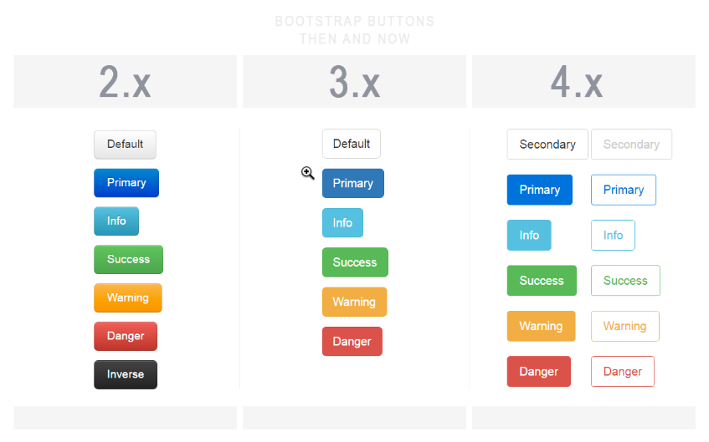
Button History

Slide 27
Component Changes – Button Groups
Dropped the .btn-group-xs class entirely given removal of .btn-xs.
Removed explicit spacing between button groups in button toolbars; use margin utilities now.
Improved documentation for use with other components.
Notes:
Renamed .btn-default to .btn-secondary.
Dropped the .btn-xs class entirely as .btn-sm is proportionally much smaller than v3’s.
The stateful button feature of the button.js jQuery plugin has been dropped. This includes the $().button(string) and $().button('reset') methods. We advise using a tiny bit of custom JavaScript instead, which will have the benefit of behaving exactly the way you want it to.
Note that the other features of the plugin (button checkboxes, button radios, single-toggle buttons) have been retained in v4.

Slide 28
Component Changes - Dropdowns
Dropdowns can be built with <div>s or <ul>s now.
Rebuilt dropdown styles and markup to provide easy, built-in support for <a> and <button> based dropdown items.
Renamed .divider to .dropdown-divider.
Dropdown items now require .dropdown-item.
Dropdown toggles no longer require an explicit <span class="caret"></span>
Notes:
Switched from parent selectors to singular classes for all components, modifiers, etc.
Simplified dropdown styles to no longer ship with upward or downward facing arrows attached to the dropdown menu.
Dropdowns can be built with <div>s or <ul>s now.
Rebuilt dropdown styles and markup to provide easy, built-in support for <a> and <button> based dropdown items.
Renamed .divider to .dropdown-divider.
Dropdown items now require .dropdown-item.
Dropdown toggles no longer require an explicit <span class="caret"></span>; this is now provided automatically via CSS’s ::after on .dropdown-toggle.

Slide 29
Component Changes – Grid System
Added a new 576px grid breakpoint as sm, meaning there are now five total tiers (xs, sm, md, lg, and xl).
Added flexbox utility classes for grid system and components.
Renamed the responsive grid modifier classes from
.col-{breakpoint}-{modifier}-{size} | .{modifier}-{breakpoint}-{size}
.col-md-3.col-md-push-9 | .col-md-3.push-md-9
Notes:
Added a new 576px grid breakpoint as sm, meaning there are now five total tiers (xs, sm, md, lg, and xl).
Renamed the responsive grid modifier classes from .col-{breakpoint}-{modifier}-{size} to .{modifier}-{breakpoint}-{size} for simpler grid classes. For example, instead of .col-md-3.col-md-push-9 it’s .col-md-3.push-md-9.
Overhauled the grid mixins to merge make-col and make-col-span into a single make-col mixin, thereby ensuring mixins and predefined classes utilize the same float/flex behaviors.
Added flexbox utility classes for grid system and components.

Slide 30
Component Changes – List Groups
Rewrote component with flexbox.
Replaced a.list-group-item with an explicit class, .list-group-item-action
Added .list-group-flush class for use with cards.

Slide 31
Component Changes – Modal
Alignment of dismiss icons in the header is likely broken
The remote option and the corresponding loaded.bs.modal event were removed.
Notes:
Rewrote component with flexbox.
Given move to flexbox, alignment of dismiss icons in the header is likely broken as we’re no longer using floats. Floated content comes first, but with flexbox that’s no longer the case. Update your dismiss icons to come after modal titles to fix.
The remote option (which could be used to automatically load and inject external content into a modal) and the corresponding loaded.bs.modal event were removed. We recommend instead using client-side templating or a data binding framework, or calling jQuery.load yourself.

Slide 32
Component Changes – Navs
Dropped nearly all > selectors for simpler styling via un-nested classes.
Instead of HTML-specific selectors like .nav > li > a, they separate classes for .navs, .nav-items, and .nav-links. This makes your HTML more flexible while bringing along increased extensibility.

Slide 33
Component Changes – Navbar
Responsive navbar behaviors are now applied to the .navbar class via the required.navbar-toggleable-{breakpoint} where you choose where to collapse the navbar.
.navbar-default is now .navbar-light, though .navbar-inverse remains the same.
Navbars now require a background declaration of some kind.
Given flexbox styles, navbars can now use flexbox utilities for easy alignment options.
.navbar-toggle is now .navbar-toggler
Dropped the .navbar-form class entirely.
Navbars no longer include margin-bottom or border-radius by default.
Notes:
Responsive navbar behaviors are now applied to the .navbar class via the required.navbar-toggleable-{breakpoint} where you choose where to collapse the navbar. Previously this was a Less variable modification and required recompiling.
.navbar-default is now .navbar-light, though .navbar-inverse remains the same. One of these is required on each navbar. However, these classes no longer set background-colors; instead they essentially only affect color.
Navbars now require a background declaration of some kind. Choose from our background utilities (.bg-*) or set your own with the light/inverse classes above for mad customization.
Given flexbox styles, navbars can now use flexbox utilities for easy alignment options.
.navbar-toggle is now .navbar-toggler and has different styles and inner markup (no more three <span>s).
Dropped the .navbar-form class entirely. It’s no longer necessary; instead, just use .form-inline and apply margin utilities as necessary.
Navbars no longer include margin-bottom or border-radius by default. Use utilities as necessary.
All examples featuring navbars have been updated to include new markup.

Slide 34
Component Changes – Pagination
Rewrote component with flexbox
Explicit classes (.page-item, .page-link) are now required on the descendants of .paginations
Dropped the .pager component entirely as it was little more than customized outline buttons

Slide 35
Component Changes - Breadcrumbs
An explicit class, .breadcrumb-item, is now required on the descendants of .breadcrumbs

Slide 36
Component Changes – Labels/Badges/Tags
Renamed .label to .tag
Dropped the .badge component
Tags are no longer floated automatically in list groups and other components.
Notes:
Renamed .label to .tag to disambiguate from the <label> element.
Dropped the .badge component as it was nearly identical to labels/tags. Use the .tag-pill modifier together with the label component instead for that rounded look.
Tags are no longer floated automatically in list groups and other components. Utility classes are now required for that.

Slide 37
Component Changes - Panels, thumbnails, and wells
Dropped entirely for the new card component.
.panel to .card, now built with flexbox.
.panel-default removed and no replacement.
.panel-group removed and no replacement. .card-group is not a replacement, it is different.
Notes:
Dropped entirely for the new card component.
.panel to .card, now built with flexbox.
.panel-default removed and no replacement.
.panel-group removed and no replacement. .card-group is not a replacement, it is different.
.panel-heading to .card-header
.panel-title to .card-title. Depending on the desired look, you may also want to use heading elements or classes (e.g. <h3>, .h3) or bold elements or classes (e.g. <strong>, <b>, .font-weight-bold). Note that .card-title, while similarly named, produces a different look than .panel-title.
.panel-body to .card-block
.panel-footer to .card-footer
.panel-primary to .card-primary and .card-inverse (or use .bg-primary on .card-header)
.panel-success to .card-success and .card-inverse (or use .bg-success on .card-header)
.panel-info to .card-info and .card-inverse (or use .bg-info on .card-header)
.panel-warning to .card-warning and .card-inverse (or use .bg-warning on .card-header)
.panel-danger to .card-danger and .card-inverse (or use .bg-danger on .card-header)

Slide 38
Card Demo
Notes:
Card Examples: http://www.codeply.com/go/C3ZSBLzAZC/bootstrap-4-card-examples
Card Centering: http://www.codeply.com/go/Kaby5SlKgM/bootstrap-4-cards-alignment

Slide 39
Component Changes – Tooltips/Popovers
Removed support for auto placement options

Slide 40
Component Changes – Carousel
For carousel items, .next, .prev, .left, and .right are now .carousel-item-next, .carousel-item-prev, .carousel-item-left, and .carousel-item-right.
.item is also now .carousel-item.
For prev/next controls, .carousel-control.right and .carousel-control.left are now .carousel-control-right and .carousel-control-left, meaning they no longer require a specific base class.
Notes:
Overhauled the entire component to simplify design and styling. We have fewer styles for you to override, new indicators, and new icons.
All CSS has been un-nested and renamed, ensuring each class is prefixed with .carousel-.
For carousel items, .next, .prev, .left, and .right are now .carousel-item-next, .carousel-item-prev, .carousel-item-left, and .carousel-item-right.
.item is also now .carousel-item.
For prev/next controls, .carousel-control.right and .carousel-control.left are now .carousel-control-right and .carousel-control-left, meaning they no longer require a specific base class.
Removed all responsive styling, deferring to utilities (e.g., showing captions on certain viewports) and custom styles as needed.
Removed image overrides for images in carousel items, deferring to utilities.
Tweaked the Carousel example to include the new markup and styles.

Slide 41
Utilities Changes
Made display utilities responsive (e.g., .d-none and d-{sm,md,lg,xl}-none).
Added .float-{sm,md,lg,xl}-{left,right,none}
Removed .pull-left and .pull-right
Added responsive variations to our text alignment classes .text-{sm,md,lg,xl}-{left,center,right}.
Added new margin auto utilities for all sides, plus vertical and horizontal shorthands.
Added of flexbox utilities.
Dropped .center-block for the new .mx-auto class.

Slide 42
Responsive Utilities Changes
All @screen- variables have been removed in v4.0.0
Notes:
Use the media-breakpoint-up(), media-breakpoint-down(), or media-breakpoint-only() Sass mixins or the $grid-breakpoints Sass map instead
Rather than using explicit .visible-* classes, you make an element visible by simply not hiding it at that screen size. You can combine one .hidden-*-up class with one .hidden-*-down class to show an element only on a given interval of screen sizes (e.g. .hidden-sm-down.hidden-xl-up shows the element only on medium and large devices).
Note that the changes to the grid breakpoints in v4 means that you’ll need to go one breakpoint larger to achieve the same results (e.g. .hidden-md is more similar to .hidden-lg-down than to .hidden-md-down). The new responsive utility classes don’t attempt to accommodate less common cases where an element’s visibility can’t be expressed as a single contiguous range of viewport sizes; you will instead need to use custom CSS in such cases.

Slide 43
References

Slide 44
References
Bootstrap v4 Guide
http://bootstrap4.guide/
Cheat Sheet
https://hackerthemes.com/bootstrap-cheatsheet
Migration Guide
https://v4-alpha.getbootstrap.com/migration
Dashboard
http://www.codeply.com/go/KrUO8QpyXP/bootstrap-4-dashboard

